Slide 1

Predicting Real Estate Value in Cook County
A Big Data Analytics Project
Team Members:
Doraiswamy, Pavithra
Iyer, Balakrishnan Mohan
Jillepalli, Mani Chandana
Mahmoudi Meymand, Mammut
Nadeem, Nimra

Slide 2
Introduction
Challenge Addressed: Enhancing real estate value predictions in Cook County.
Primary Goal:
Issues Tackled:
Data Utilized:
Project Complexity:
Methodologies:
Validation:
.
Objective Achieved:
Refining the property valuation process at the Cook County Assessor’s Office (CCAO).
Historical problems with transparency and efficiency in property valuations.
Training data: "historic_property_data.csv"
Validation data: "predict_property_data.csv"
Diverse property types ranging from urban environments in Chicago to over 130 suburbs.
Developed predictive models linking property features to sale prices
Employed advanced analytics and machine learning techniques in R
Models tested against new datasets to ensure robustness and real-world applicability
Streamlined property appraisal process in Cook County, enhancing transparency, efficiency, and accuracy.

Slide 3

Data Cleaning and Preparation
Loading Essential Libraries:
tidyverse for data manipulation.
glmnet for advanced modeling.
Data Import and Exploration:
Imported "historic_property_data.csv".
Utilized str() and head() functions to examine dataset structure.
Feature Selection:
Removed non-predictive columns.
Renamed remaining columns for clarity and relevance.

Slide 4

Data Cleaning and Preparation
Handling Missing Values:
Function implemented to count nulls.
Discarded columns with over 10% missing values.
Missing values imputed or excluded to preserve data integrity.
Handling Unique Values:
Removed columns with excessively high or low unique values to prevent overfitting.
Categorical Variable Conversion:
Transformed into factors for precise analysis and model training.
Outlier Management with Z-Value Method:
Calculated Z-scores to identify and manage outliers, standardizing treatment to enhance model robustness.

Slide 5

Variable Selection
Forward Selection:
Start with no variables, add one by one.
Include variables that significantly enhance the model.
Stop when additional variables don’t improve the model.
Backward Elimination:
Begin with all potential predictors.
Remove the least significant variables first.
Conclude with only statistically significant variables.
Stepwise Selection:
Combine forward addition and backward removal.
Adjust model iteratively for statistical soundness.
Benefit: Dynamic model building for refined predictors.

Slide 6

Lasso Regression
Reasons:
Addresses multicollinearity and high predictor-to-observation ratios.
Applies L1 regularization to penalize the regression coefficients' magnitude.
Key Features:
Penalty Application: Regularization term (lambda, λ) reduces coefficient size, driving less important variables' coefficients to zero.
Lambda Optimization: Explores lambda values to minimize model error, enhancing model simplicity and performance.

Slide 7

Outcome:
Improved Accuracy:
Achieved lower Mean Squared Error (MSE) compared to traditional methods.
Enhanced Interpretability:
Resulted in better model clarity and easier understanding of predictions.
Feature Reduction:
Retained only variables with strong predictive power.
Simplified Model:
Streamlined the model by eliminating extraneous features.
Enhanced Performance:
Boosted predictive performance through focused variable selection.

Slide 8
Cross-Validated Lasso Regression Modeling
10-Fold Cross-Validation:
Divides the dataset into 10 equal parts.
Uses each part for validation once while training on the remaining nine.
Enhances generalizability and prevents overfitting.
Lambda Optimization:
Focuses on selecting the best lambda (λ) value.
Tests different lambda values in each fold to minimize Mean Squared Error (MSE).
Balances bias and variance, optimizing model performance.
Alpha Parameter:
Set to 1, enforcing L1 regularization.
Enhances model sparsity by shrinking less critical coefficients to zero.
Impact on Model:
Retains only impactful predictors, simplifying interpretation.
Provides clear insights into significant factors affecting real estate values.
Strategic use of Lasso regression refines predictive capabilities and ensures reliable accuracy on unseen data.

Slide 9
Prediction and MSE Calculation
Prediction Process:
Utilized the finalized model to make predictions on the test set.
Test set reserved from the model training phase for unbiased evaluation.
MSE (Mean Squared Error) as Primary Metric:
Quantifies average squared differences between estimated and actual values.
Comprehensive measure of prediction accuracy.
Results:
Lowest MSE recorded: 15,903,578,320.
Demonstrates the model's robustness and precision in capturing data patterns.
Model Applicability and Impact:
Confirms precision and highlights real-world applicability.
Provides valuable insights for real estate analysts and policymakers on property valuation.

Slide 10
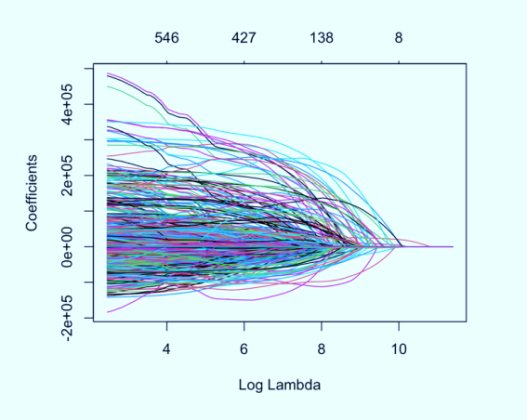
Conclusion and Impact
Modeling Approach:
Utilized cross-validated Lasso regression.
Proven effective in predicting property values in Cook County.
Achievements:
Rigorous variable selection and model optimization.
Achieved high predictive accuracy and enhanced interpretability.
MSE Reduction:
Significant reduction in Mean Squared Error to 15,903,578,320.
Demonstrates the model's practical relevance and reliability.

Slide 11
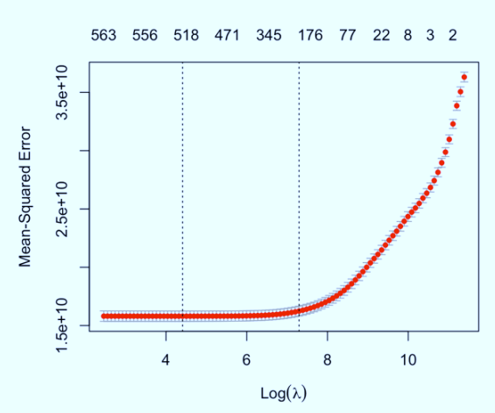
Impact on Property Assessments:
Promising results for aiding Cook County Assessor’s Office.
Potential for refining property assessment processes.
Future Potential:
Provides a foundation for future enhancements.
Allows targeted policy and equitable tax assessments.
Broader Contributions:
Advances technical aspects of property valuation.
Contributes to more transparent, efficient, and fair property tax assessments.
Sets the stage for further research and broader applications in real estate analytics.

Slide 12
Work Done By Members:
Doraiswamy, Pavithra: Treat null values, Treat outliers, Lasso regression and Assessed values
Iyer, Balakrishnan Mohan: Presentation and Backward Elimination and Stepwise Regression
Jillepalli, Mani Chandana: Data cleaning techniques, imputing missing values, null values, removal of non-predictive columns, backward elimination, forward selection, and stepwise regression. Documentation on Data Preprocessing
Mahmoudi Meymand, Mammut: Backward, Forward and Stepwise Variable Selection
Nadeem, Nimra: Report and Project Summary and Forward and Backward Regression

